Slide 1

Algorithmic Arms Race:
Using Genetic Variation to Predict Malaria Risk with Machine Learning
Bashir Aminu Bello | Healthcare Data Science & AI | 2025 Extension of "Genetic Arms Race: Sickle Cell vs. Malaria"

Slide 2

Why Sickle Cell Trait Isn’t Enough
Limited Protection
Parasite-Dependent Efficacy
Population vs. Individual Risk
Sickle cell trait (HbAS) reduces malaria risk, but this protection isn't absolute for all infections.
Research by Band et al. (2022) revealed that the level of protection depends critically on the genetics of the malaria parasite, not solely on the human host's genetic trait.
While this insight helps explain population-level patterns of malaria prevalence, it does not provide a reliable method for assessing an individual's precise risk or informing personalized interventions.
(1) - Problem & Motivation

Slide 3




From Biology to Prediction
Our goal is to estimate malaria risk at the individual level, leveraging genetic information available at diagnosis.
Key Shift:
Population Insight
Individual Prediction
Static Genetic Defense
Probabilistic Risk Score
Understanding disease patterns across groups
Tailoring risk assessment to each patient
Generic understanding of genetic traits
Dynamic, data-driven assessment of risk
(2) - Data + synthetic strategy

Slide 4
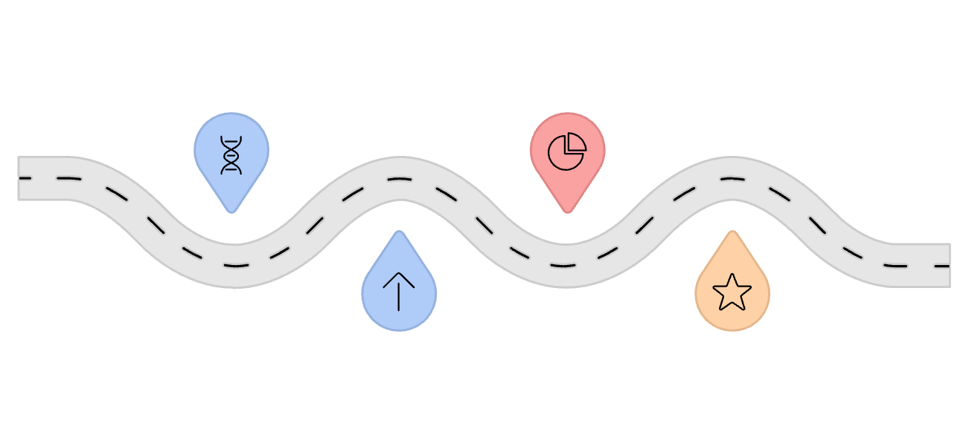
How a Genetic Risk Score Is Computed
Calculation for rs334 (HBB - Sickle Cell)
Tai & Dhaliwal (2022) incorporated mutation chromosomal position (POS) into weighted genetic risk calculation.
Genotype
HbAS (1)
Risk Allele
Frequency
Effect
-0.85 (protective)
rs334
Freq (0.32)
Frequency
0.32 (Hardy-Weinberg)
Position
5,227,002 bp
Index
1 (SNP priority)
Effect
Position
Result
Decreases genetic risk score
Effect (0.85)
5,227,002 bp
Chromosome 11
(3) - Compute wGRS + GF + POS → Genetic Risk Score
wGRS: Weighted Genetic Risk Score
GF: Genomic features (genotype frequencies)
POS: Genomic position information
Adapted from Tai & Dhaliwal, Journal of Big Data (2022), CC-BY 4.0

Slide 5
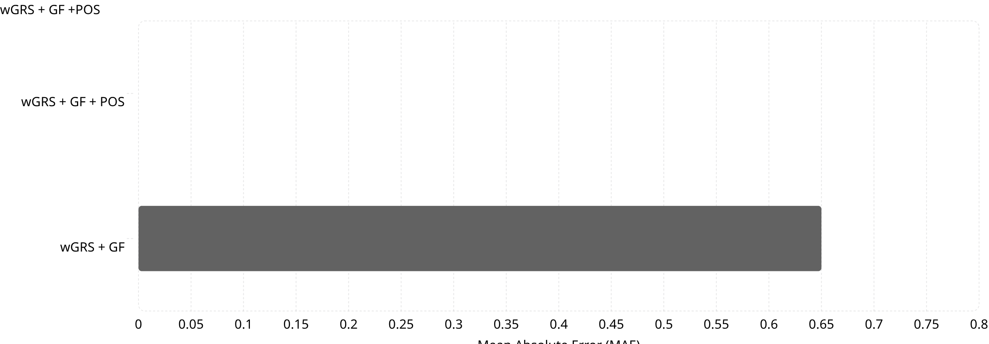
Mutation Location Dramatically Improves Prediction
0.00003
0.00000
0.65000
Including mutation location (POS) dramatically reduces prediction error, as shown by the significant decrease in Mean Absolute Error (MAE).
(4) - Primary result
Adapted from Tai & Dhaliwal (2022), Applied Sciences 12(9):4513.

Slide 6




Models Evaluated
To assess whether the accuracy gains from incorporating genomic position persist across modeling choices, several machine learning models were trained to predict individual malaria risk, spanning linear, kernel-based, tree-based, and neural architectures. Performance is evaluated using mean absolute error (MAE), where lower values indicate better predictive accuracy.
LightGBM
Support Vector Regression
MAE: 3.00e-05
MAE: 8.19e-04
(High performance, gradient-boosting framework)
(Effective for complex, non-linear relationships)
Shallow MLP
Ridge Regression
MAE: 7.82e-04
Mean Absolute Error: 5.74e-08
(Neural network with minimal layers)
(Baseline, highly interpretable)
(5) - Secondary Result

Slide 7
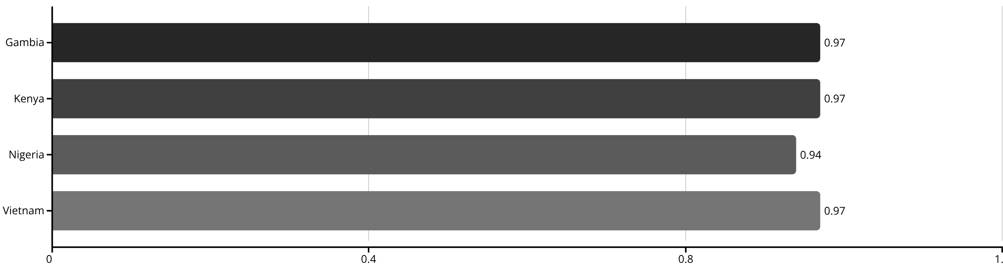
Cross-Population Sensitivity Check
1.00
0.06
0.0
Demographic Parity Ratio
TPR Disparity (Max)
Calibration Error
(Passes 4/5ths Rule: >0.80)
(range 0.94–0.99)
across all populations
Cross-population sensitivity is assessed to ensure predictive stability across geographic groups.
0.06
Equalized Odds (ΔFPR)
(acceptable)
Sensitivity Across Geographic Populations
(6) - Sensitivity Testing
Fairness metrics calculated per IEEE 2857-2021 Standard

Slide 8

Limitations
Synthetic Genotypes
Host Genetic Risk Only
External Validation Required
Our model uses synthetic genotypes that approximate population structure, but they do not fully capture complex linkage disequilibrium present in real-world data.
The current model predicts host genetic risk exclusively, without accounting for the critical influence of the parasite's genotype, which impacts infection outcomes.
Robust validation of the model's performance on independent, individual-level MalariaGEN data is a crucial next step to confirm its generalizability and accuracy.
(8)

Slide 9




Governance Frameworks for Clinical AI
FDA (United States)
EU AI Act (Annex III)
GINA & NDPR
Class II Medical Device
High-Risk System
Genetic Privacy
Status: Research Use Only → 510(k) premarket notification required
Class II Medical Device (Software as Medical Device)
Reference: FDA Software as Medical Device (SaMD) Guidance; 21 U.S.C. §360(k)
• Status: Biomedical risk prediction requires CE marking + post-market surveillance
• rs334 Status: Protected variant — prohibits insurance/employment discrimination
• Reference: Regulation (EU) 2024/1689, Art. 6 & Annex III
• Nigeria: Genomic data must remain in-country (NDPR 2019)
• Reference: GINA 42 U.S.C. §2000ff | NDPR
(9) - Regulatory Limitations

Slide 10

Why This Project Matters
Translating Insight into System
Feature Design over Complexity
Foundation for Future Work
Demonstrates how deep biological insight can be effectively translated into a robust and functional machine learning system.
Highlights the critical importance of thoughtful feature engineering in achieving predictive power, often surpassing model complexity.
Lays a crucial foundation for incorporating more granular parasite genetics and real-world clinical data in future research.
Synopsis: Observed genotype-dependent malaria protection (Band et al., 2022) was formalized using a position-weighted genetic risk framework (Tai & Dhaliwal, 2022) and extended here into a predictive, cross-population machine learning system.

Slide 11
References
Genetic Protection & Parasite Adaptation
Band et al. (2022). Malaria protection due to sickle haemoglobin depends on parasite genotype. Nature.
Gómez-Díaz & Ranford-Cartwright (2022). Evolutionary race: Malaria evolves to evade sickle cell protection. Cell Host & Microbe.
Kwiatkowski (2005). How malaria has affected the human genome. AJHG.
Biological Mechanisms
Gong et al. (2013). Mechanisms by which sickle cell trait protects against malaria. Malaria Journal.
Rowe et al. (2009). PfEMP1 adhesion mechanisms. Expert Reviews in Molecular Medicine.
Lalchhandama (2017). PfEMP1 overview. WikiJournal of Medicine.
Eridani (2011). Sickle cell protection from malaria. Hematology Reviews.
Clinical & Global Context
WHO (2022). World Malaria Report.
Hanboonkunupakarn & White (2020). Advances and roadblocks in malaria treatment. BJCP.
Sinha et al. (2014). Drug-resistant malaria. Parasite.
WHO (2013). Malaria Vaccine Technology Roadmap.
Machine Learning Reference
Tai, Y.-S. & Dhaliwal, S. (2022). Machine learning model for malaria risk prediction based on mutation location. Applied Sciences, 12(9):4513.

